Slide 1


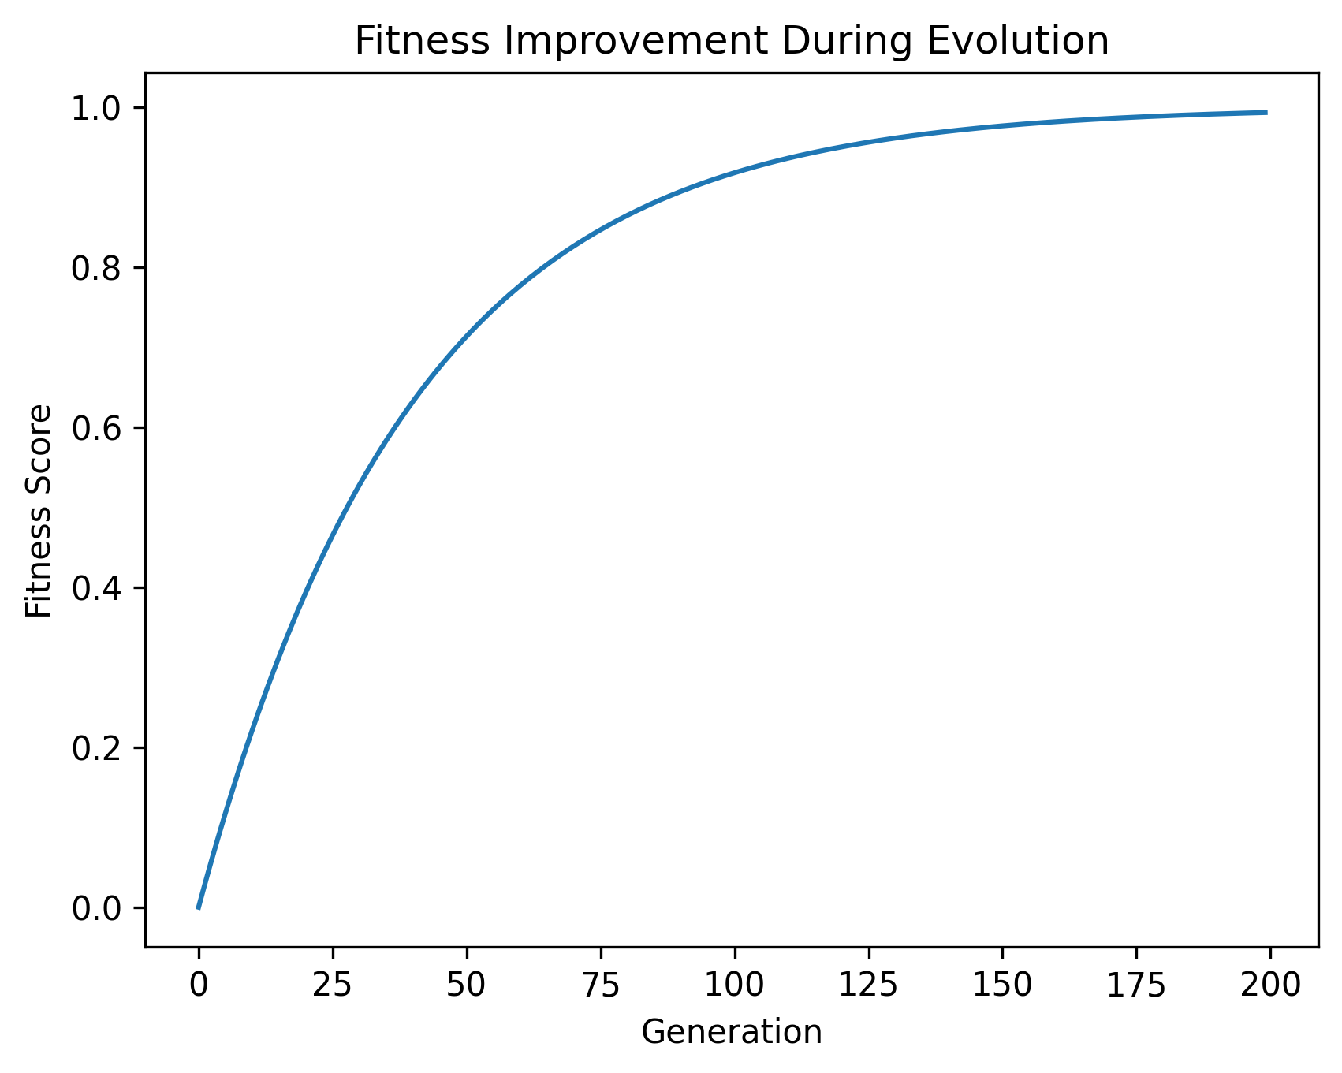
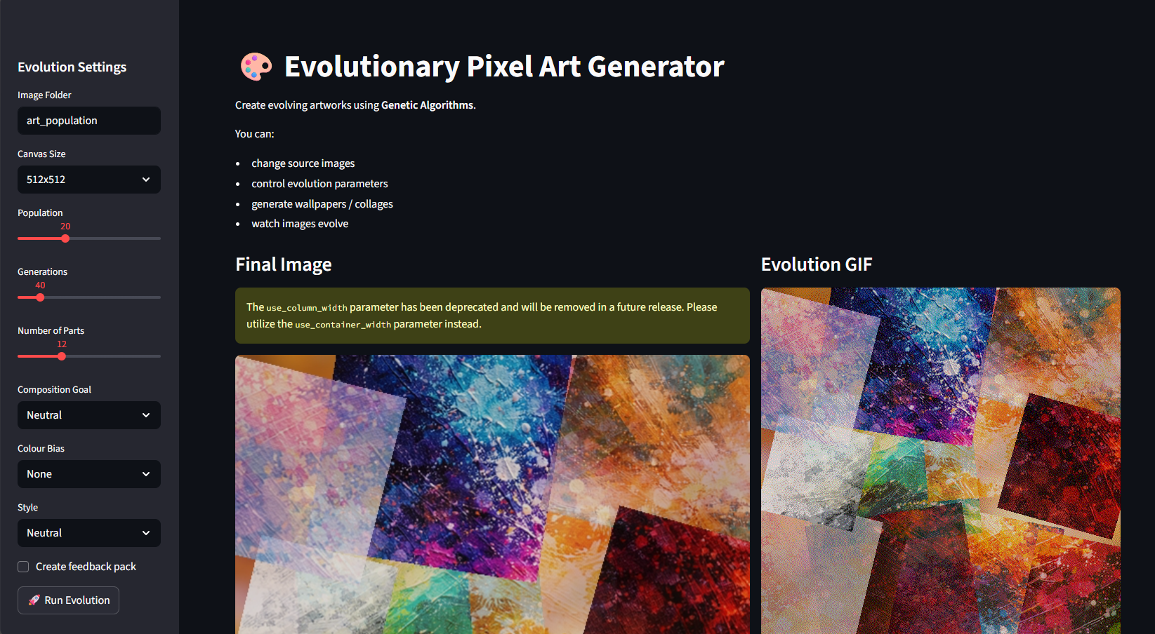
ART GENERATION WITH EVOLUTIONARY ALGORITHMS
Name: ENOMA IGUISI Supervisor: DR RICCARDO POLI
. Project Overview:
This project investigates how Genetic Algorithms (GAs) can be used to generate pixel art automatically. A population of images evolves towards a target image using evolutionary operators such as selection, crossover and mutation.
The system allows users to upload an image and observe how a population of candidate images gradually evolves to approximate the target.
Evolution Gif
Results:
The system successfully evolves images that approximate the target over many generations
Increasing population size improves image quality but increases computation time
Mutation rate strongly influences diversity and convergence speed
Methodology:
1. Initial Population
Random pixel images generated.
2. Fitness Evaluation
Each image compared to the target image.
Fitness = pixel similarity.
3. Selection
Tournament selection chooses parents.
4. Crossover
Parents combine to create offspring.
5. Mutation
Random pixel changes maintain diversity.
6. Replacement
New generation replaces the old.
Key Code Features
• Generational genetic algorithm evolving pixel images • Tournament selection for parent selection
• Pixel mutation introducing colour variation
• Fitness function comparing generated and target images
• Streamlit interface for interactive evolution and visualisation
Future Enhancements:
Parallelised evolution for faster results
Improved fitness functions
Multi-objective optimisation
Higher resolution art generation
Application UI

